Slide 1
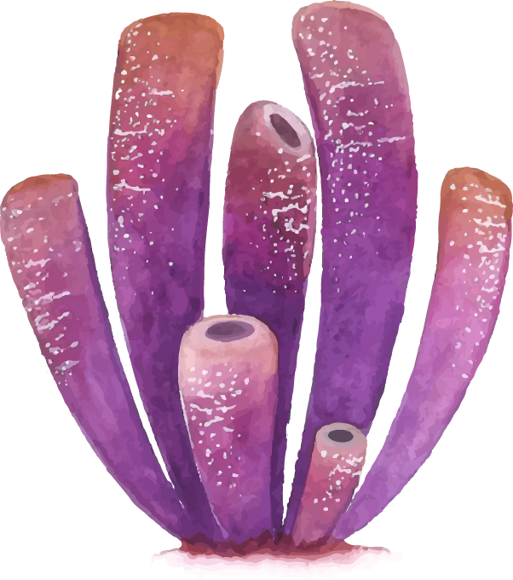

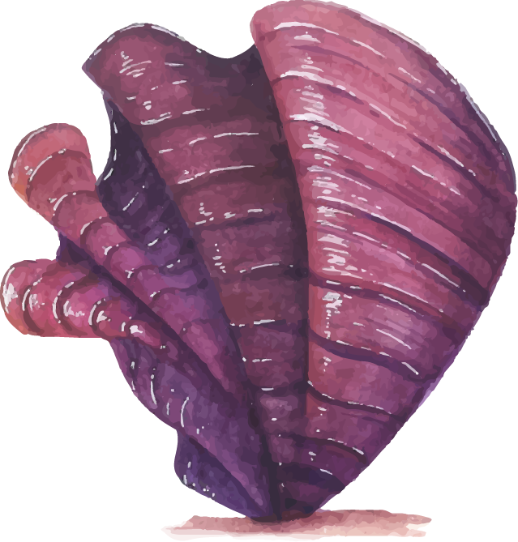
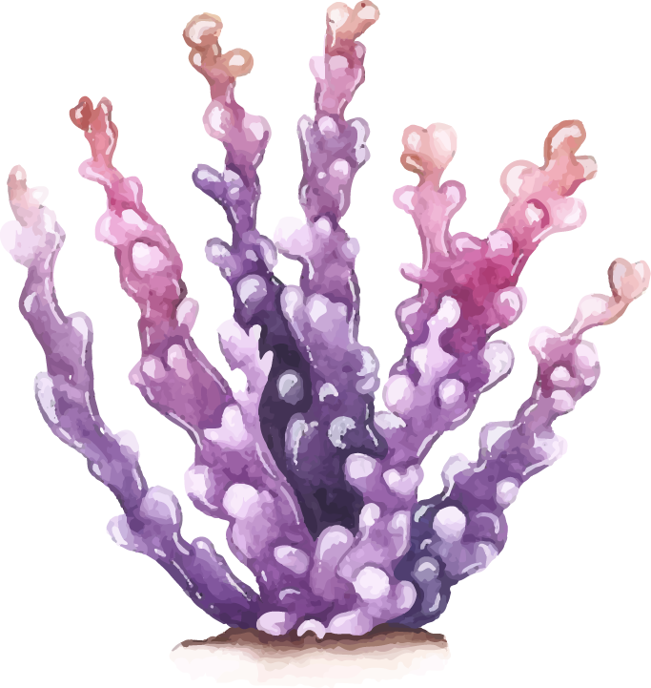
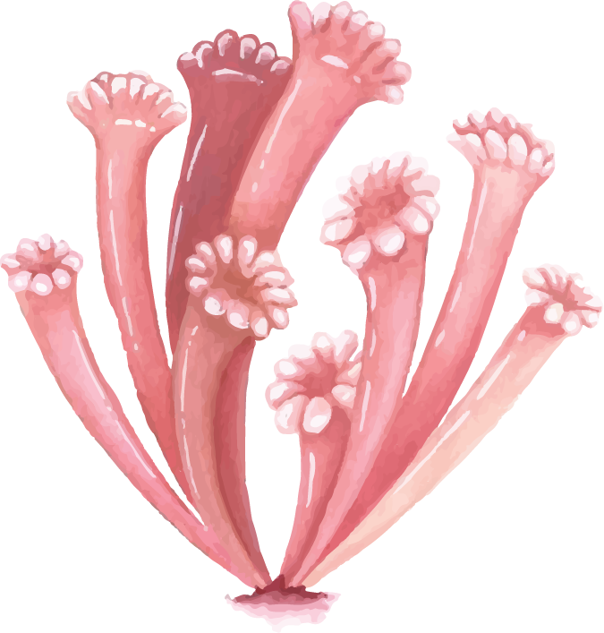
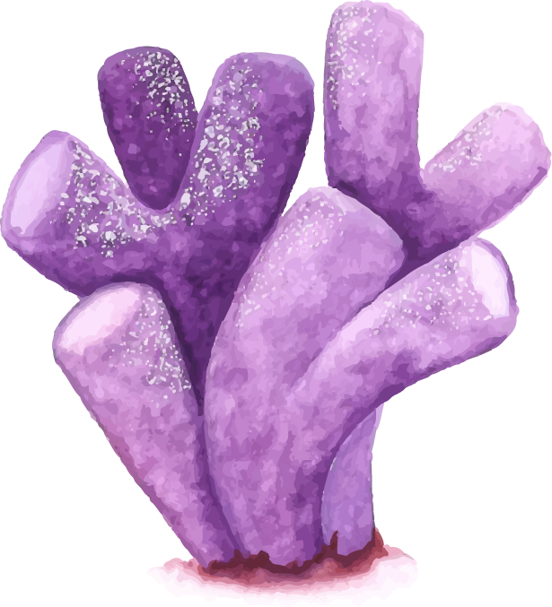
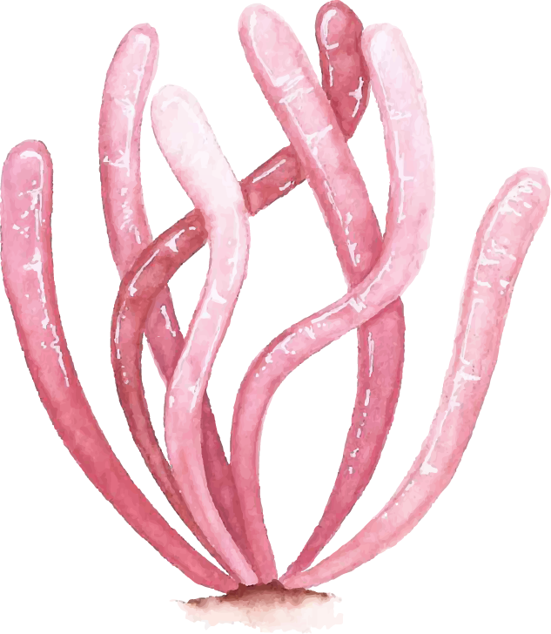
Effect of Stressors on Urbanized Corals
Denny, Zeng Qi, Alexander TF: Daniel

Slide 2
Disclaimer
Confidentiality and Usage of Materials
All materials, including but not limited to slides, documents, data, and other information, presented and shared herein belong exclusively to our client. Unauthorized duplication, distribution, transmission, display, or use of this information, in whole or in part, is strictly prohibited.
Attendees and recipients of these materials are expressly forbidden from:
Taking photographs, screenshots, or any other forms of reproductions of the slides or any related information.
Leaking, sharing, or uploading any of the provided information to the public or any third-party platform, either online or offline.
Breach of this confidentiality agreement may result in legal consequences. We ask that you respect our client's rights and wishes by maintaining the confidentiality of the materials and information provided.
Thank you for your understanding and cooperation.

Slide 3
Background Introduction
Exploratory Data Analysis
Future Goals
Agenda

Slide 4

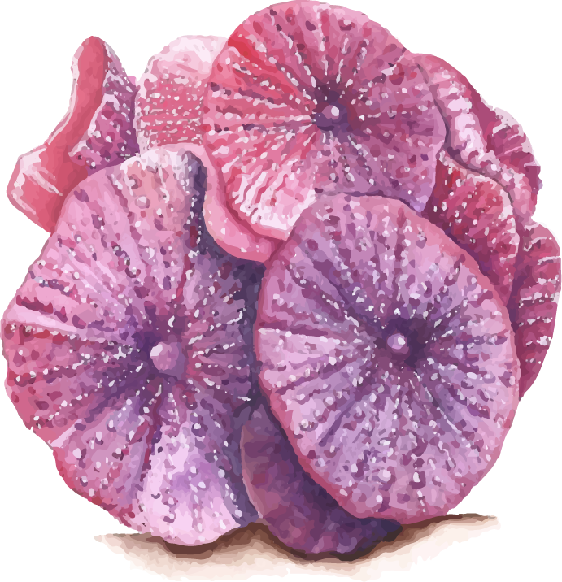
Caroline is a PhD candidate at Urban Program
Urban Biogeoscience and Environmental Health
A member of the Rotjan Marine Ecology Lab
Investigating the physiological effects of urban pollutants on the temperate coral Astrangia poculata in Narragansett Bay, Rhode Island

Slide 5
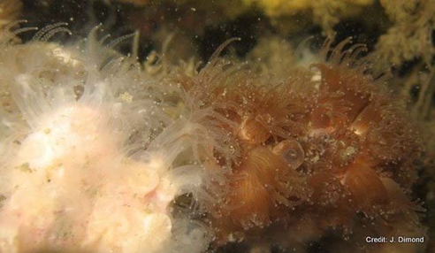
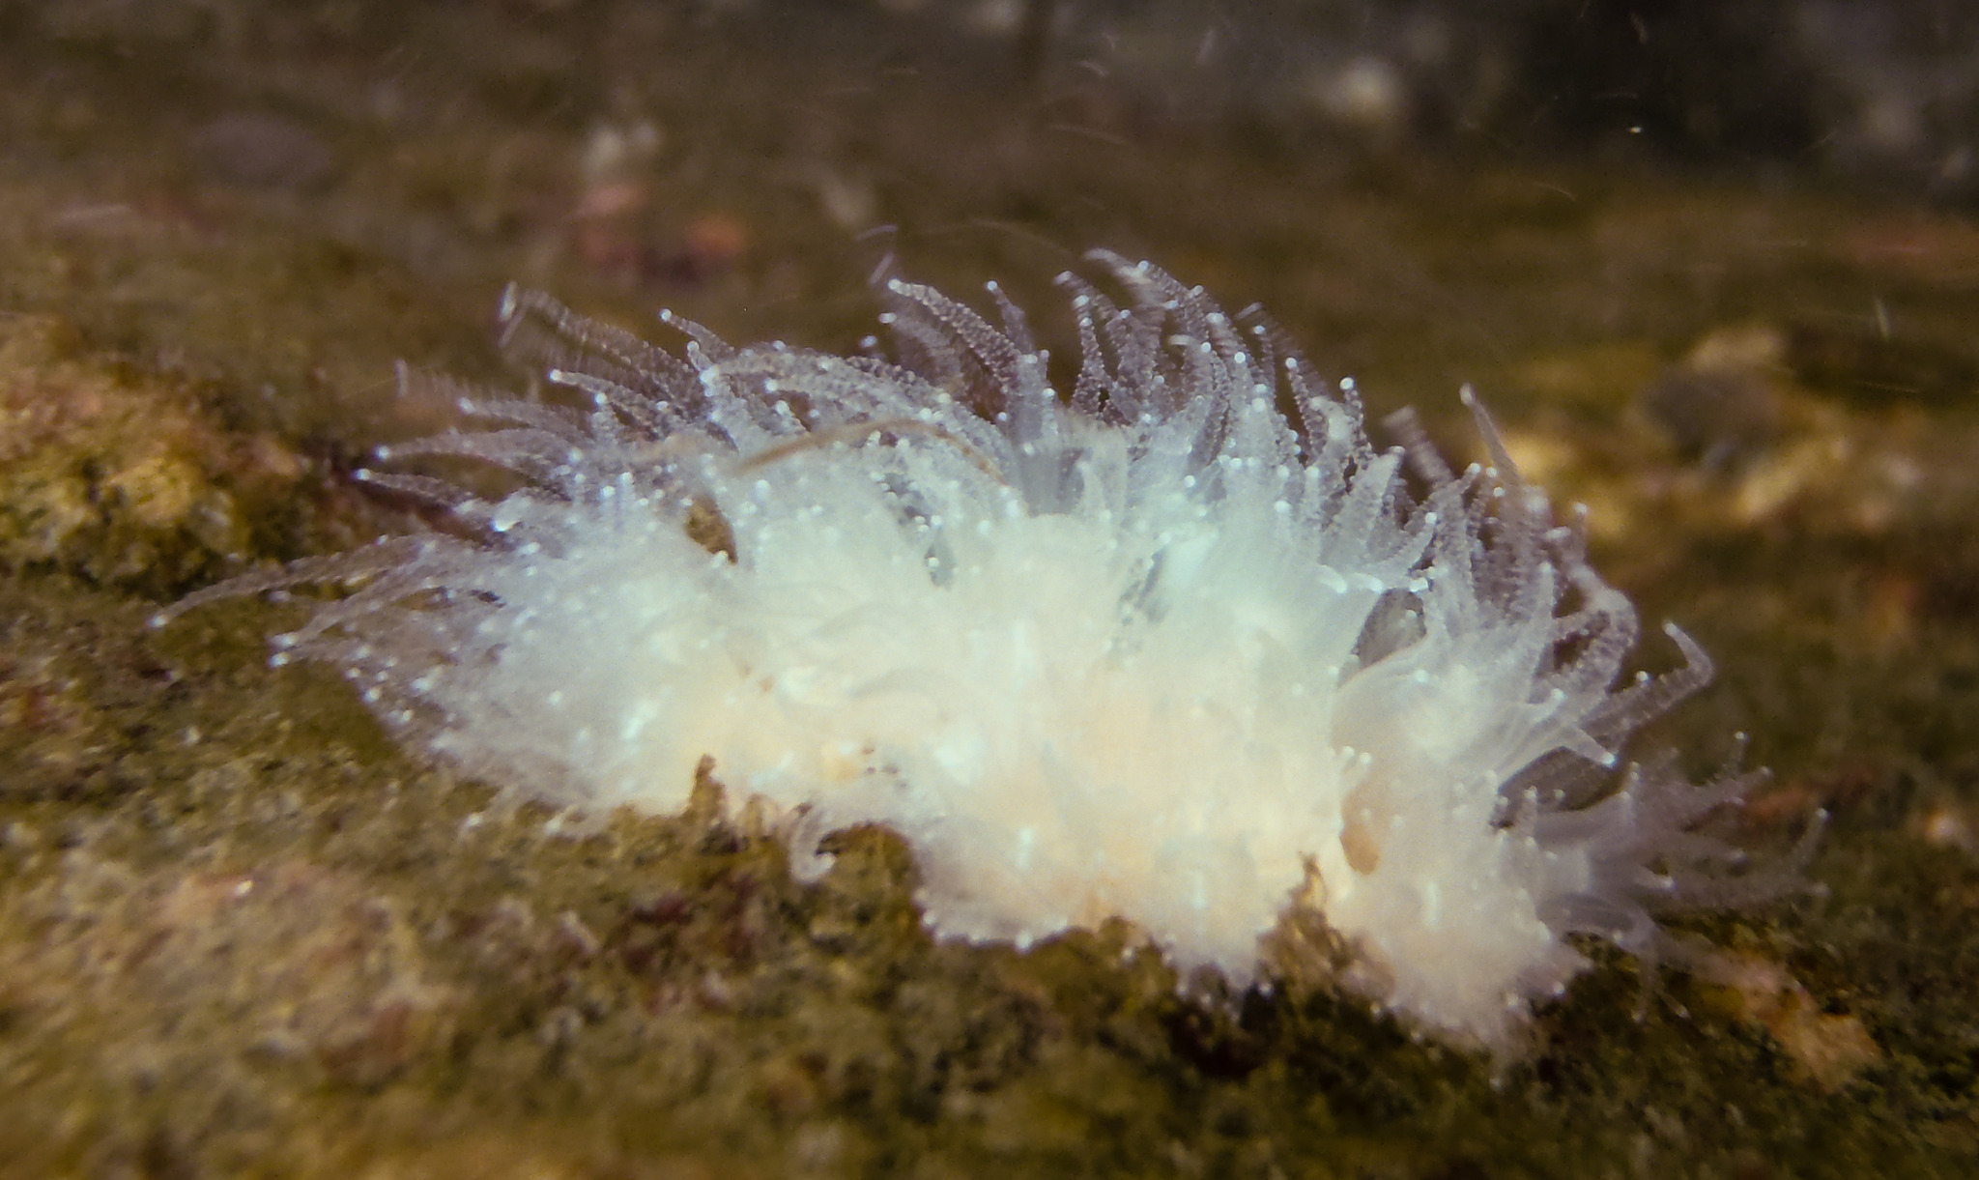
Astrangia poculata is the subject of our client's research

Slide 6
Corals lives in urban areasin
Northeastern USA
NYC
Providence
New Bedford
Miami, Florida
Natal,
Brazil
Caribbean
Kingston, Jamaica
Port-au-Prince, Haiti
Santo Domingo, Dominican Republic
San Juan, Puerto Rico
Cancun, Mexico
Havana, Cuba
Barranquilla, Colombia
Cartagena, Colombia

Slide 7
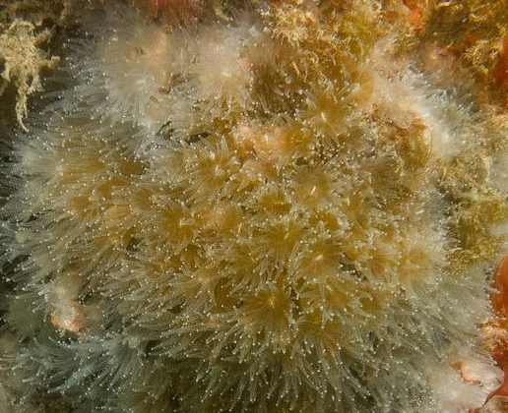
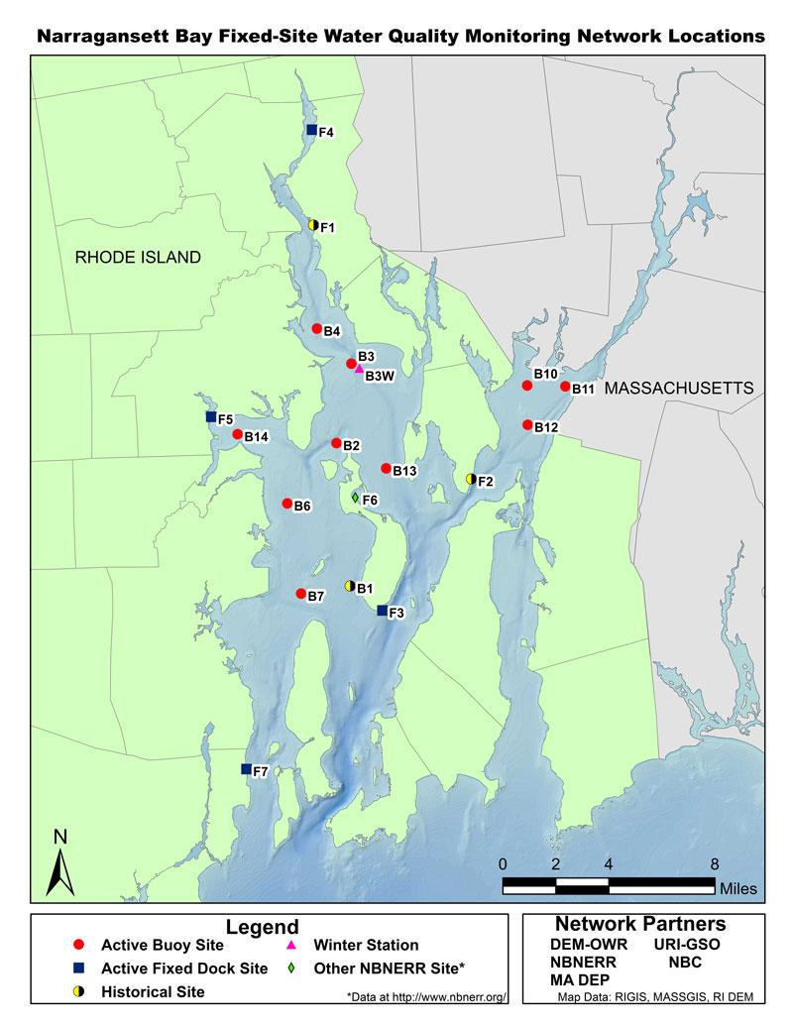
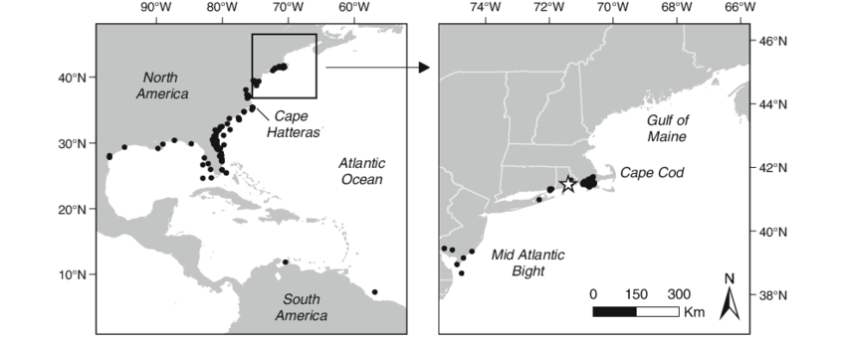
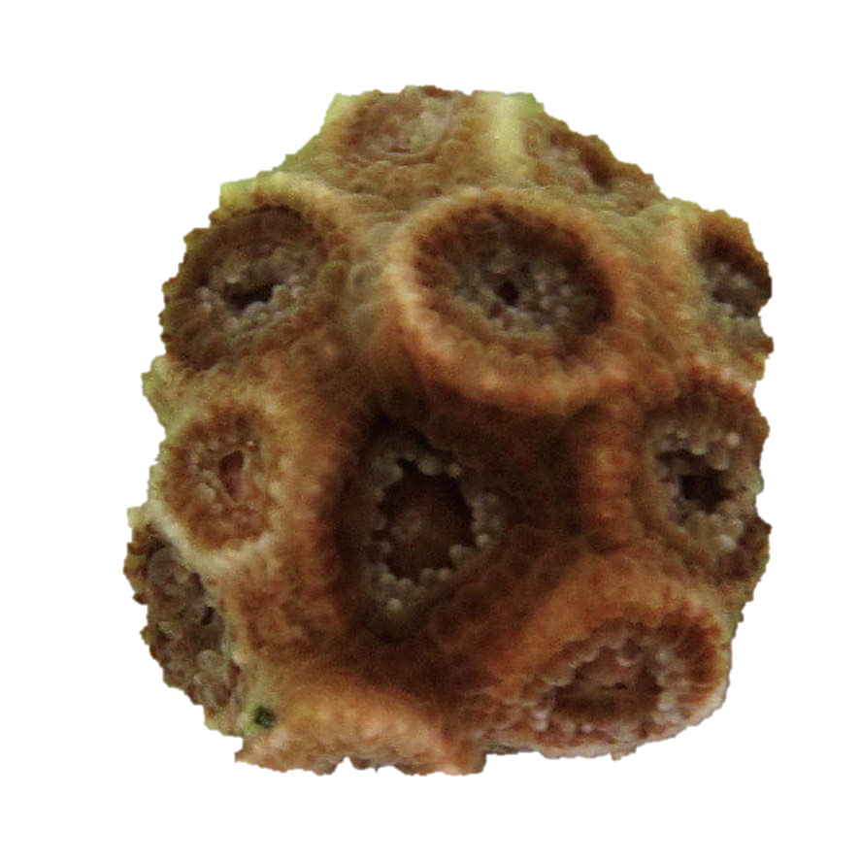
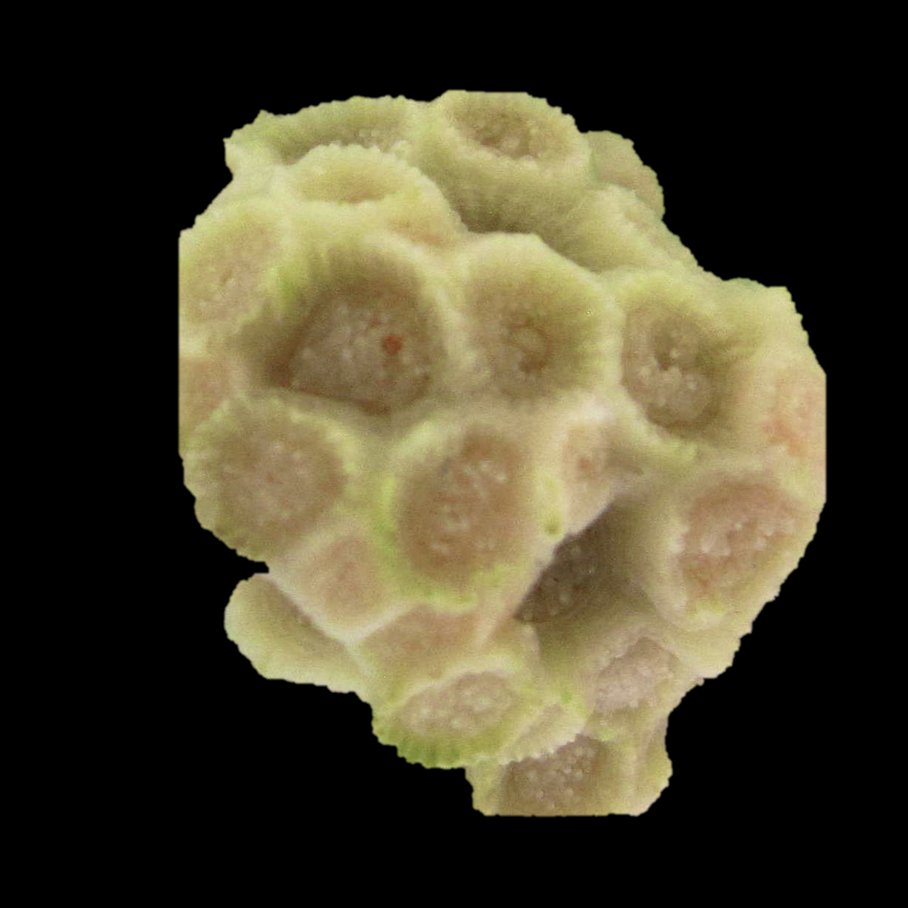
Astrangia poculata is an urban coral
Narragansett Bay, RI
Established history of nutrient and bacterial pollution
Balint et al. 2021, Tyrell et al. 1995
Large population of A. poculata

Slide 8
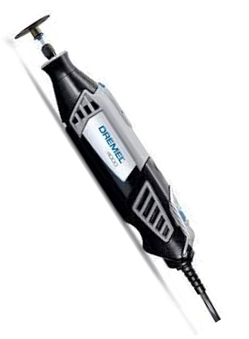
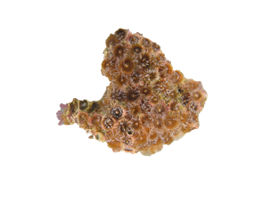
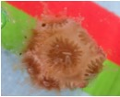
Research Process
Sample acquisition
Diving and coral collection
Coral fragmentation & assigning
4mm

Slide 9
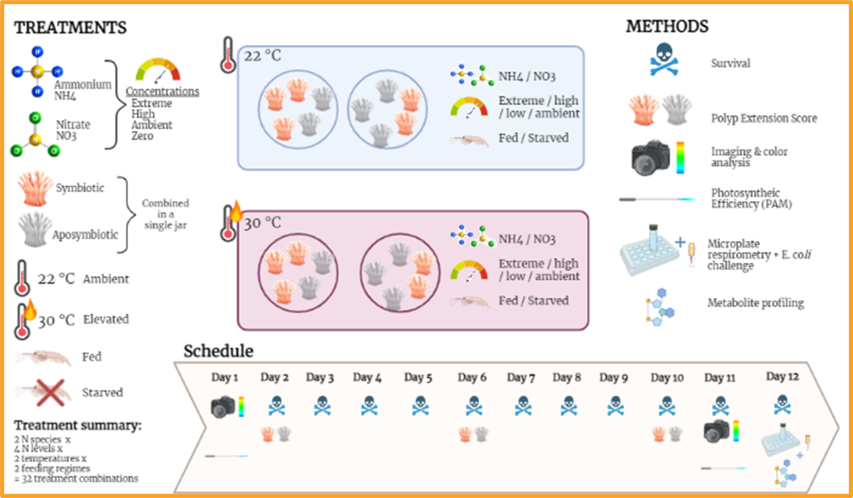

Slide 10
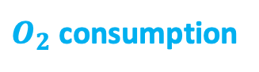
We eventually obtain four outcomes.
PAM (numerical)
Respiration (numerical)
RGB (numerical)
Behavior (Interger)
Symbiont health
$O_{2}$ consumption
Red value = Breaching
1 ~ 5 score

Slide 11
We broke down the `treat_ID_full` column
into five different treatment factors.
A_0_20_F_A
Pollution Type
A: Ammonium
N: Nitrate
Symbiont
A: Apo Symbiotic
S: Symbiotic
Dose Level
Feed
F: Fed
S: Starved
Dose Level | Nitrate | Ammonium
Control | 0 | 0
Low | 1.5 | 5
Medium | 5 | 7.5
High | 18 | 10
Temperature
20: 20°C
30: 30°C

Slide 12
And our first goal is the change in photosynthetic efficiency (PAM ∆%)
Pulse Amplitude Modulation (PAM) is a measurement of Photosynthesis.
Pam_avg_day1
Average PAM on Day 1.
Pam_avg_day11
Average PAM on Day 11.
Pam_delta
Pam_avg_day11 – Pam_avg_day1
Pam_percent_change
Pam_delta / Pam_avg_day1
Pam_delta > 0 : increase -> better
Pam_status
Pam_delta <= 0 : decrease -> worse

Slide 13
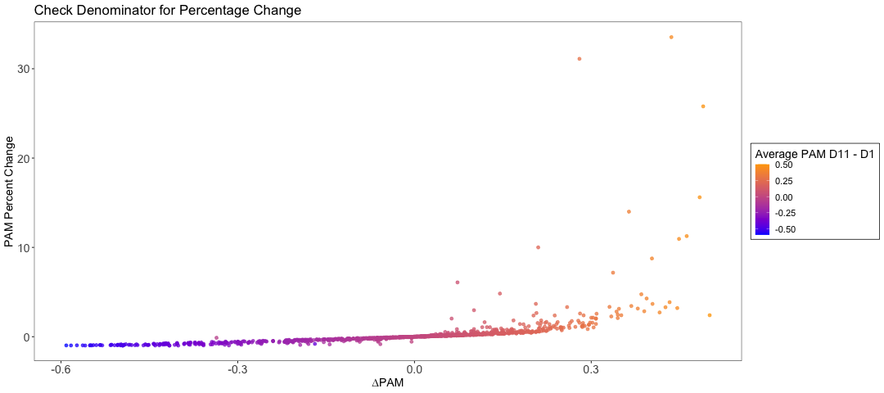
Since we are interested in percentage change, scale of the denominator matters.

Slide 14
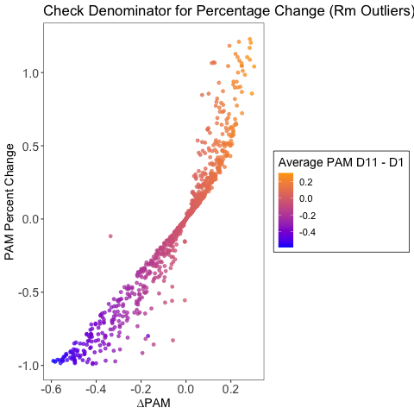
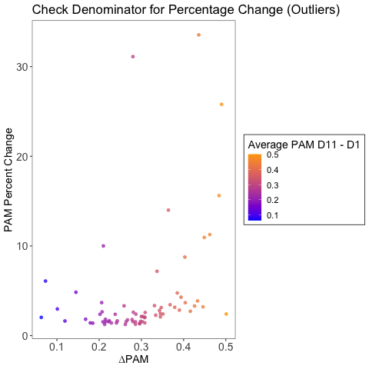
We boldly believe that higher ∆PAM reflect a greater PAM percentage change.

Slide 15
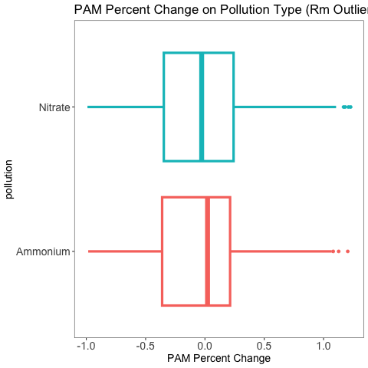
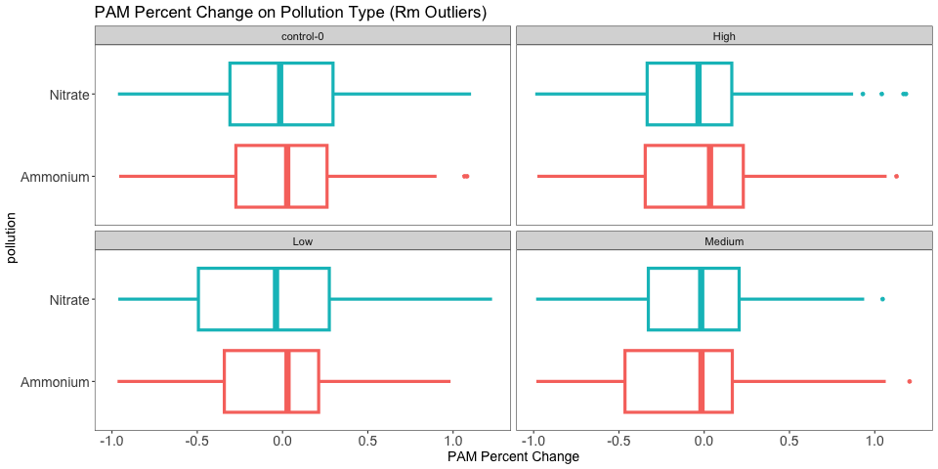
But The univariate analysis results did not
show significant differences in the PAM change.
r)

Slide 16
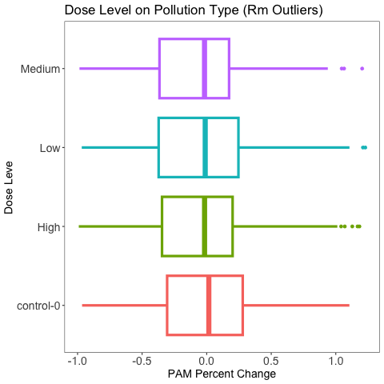
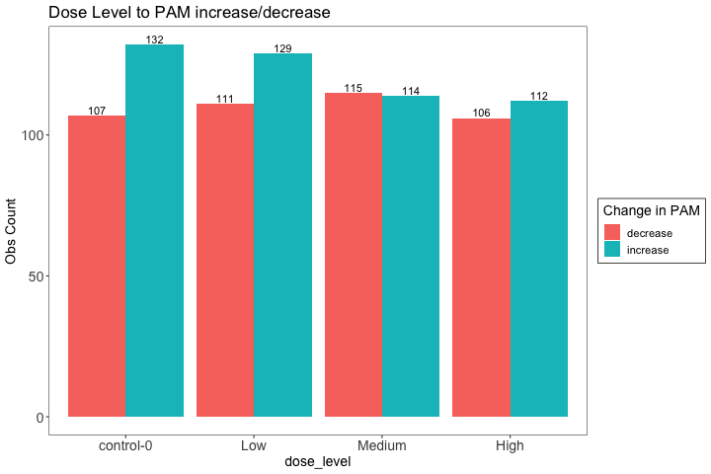
Looking solely at dose levels, there was no decisive difference.

Slide 17
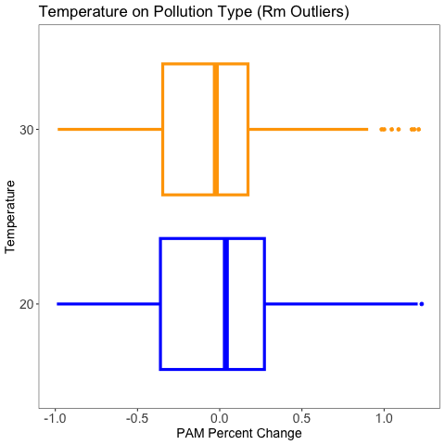
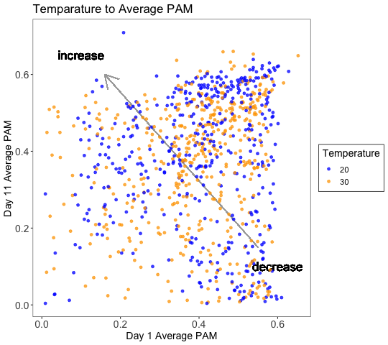
Neither the temperature factor.

Slide 18
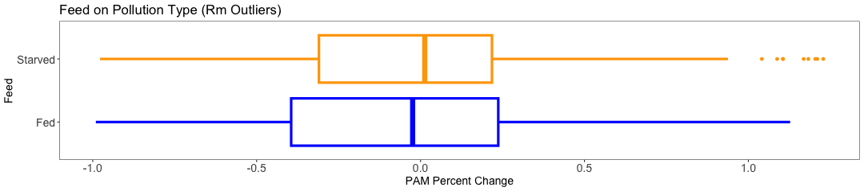
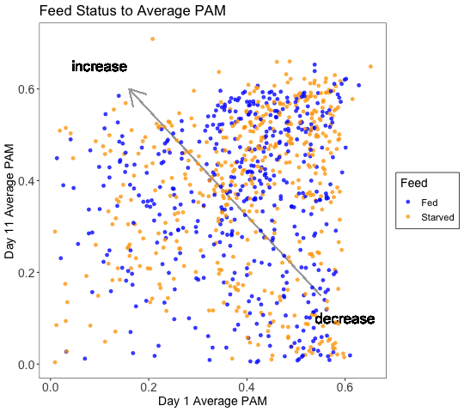
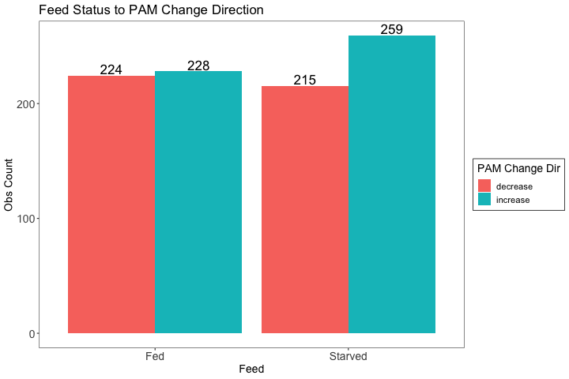
Also, there isn’t an obvious difference on the Feed factor.

Slide 19
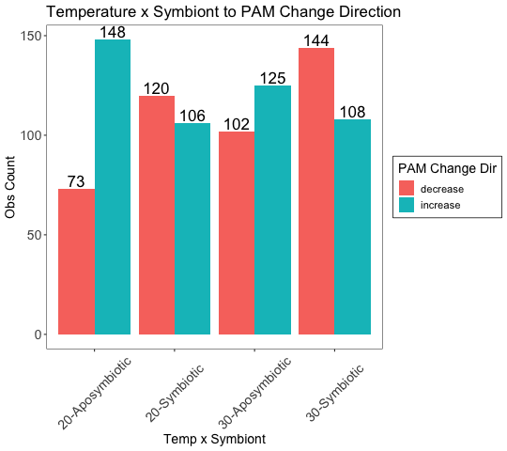
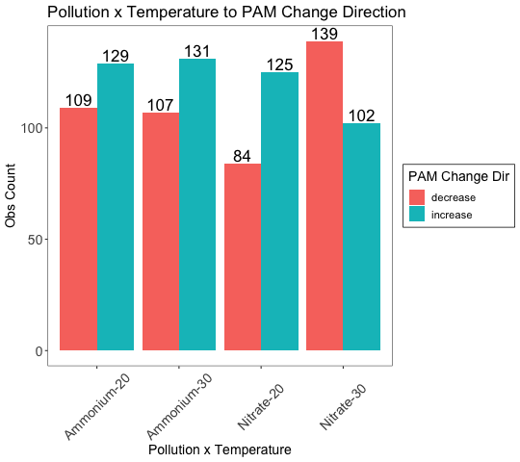
But things go different when we started looking at factors combinations.

Slide 20
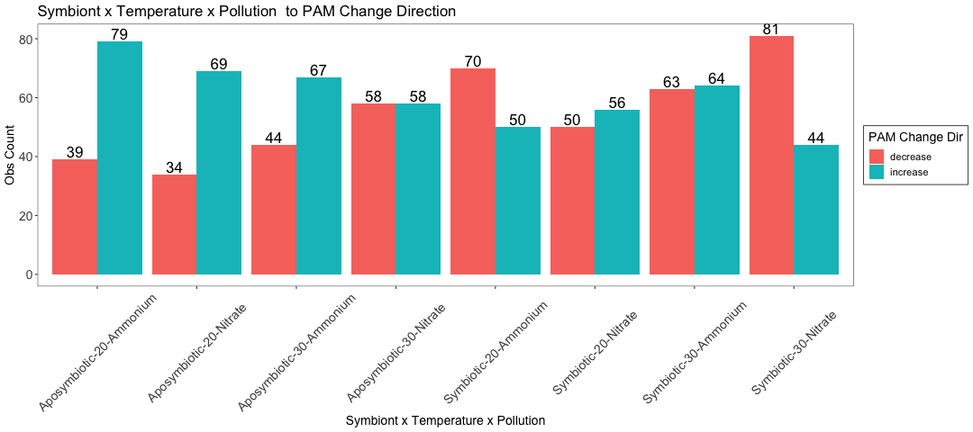
The PAM change direction becomes more
apparent as the combination gets more complicated.

Slide 21
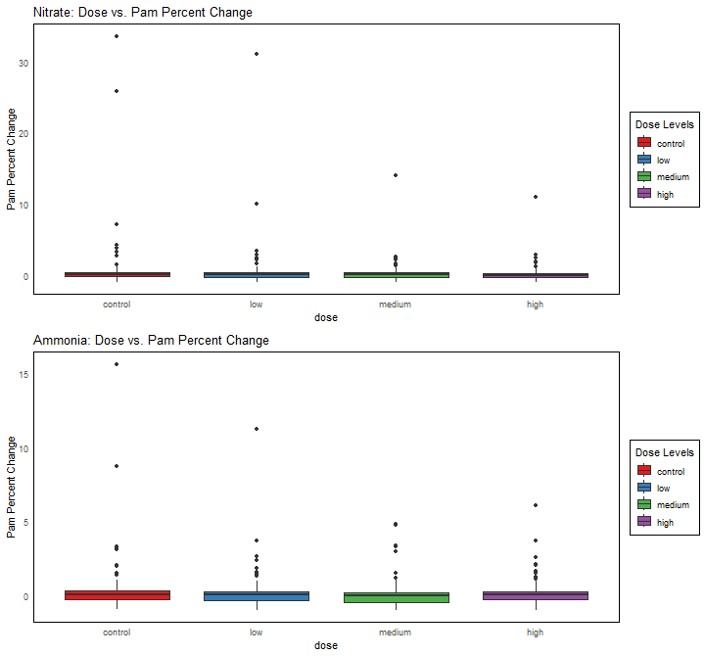
Dose = 0 is the control group.
Nitrate dataset
there is a significant variability at low and medium doses, while the variation at high doses is relatively small
Ammonia dataset
the highest variability is observed at medium doses.

Slide 22
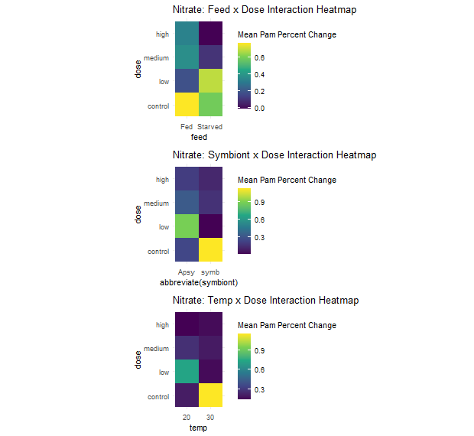
pollution is Nitrate :
The dose has interactive effects
Feed x Dose:
In both Starved and Fed states, as the dose increases, pam_percent_change decreases.
Symbiont x Dose:
With symbionts, pam_percent_change values are higher at low dose levels and decrease at other levels.
Without symbionts, pam_percent_change values are lowest at the low dose level and increase at medium and high doses.
Temp x Dose:
At 20°C, pam_percent_change values remain at lower levels.
At 30°C, pam_percent_change decreases rapidly with increasing dose.

Slide 23
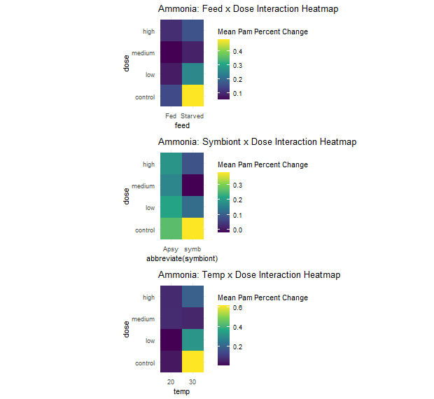
pollution is Ammonia :
The dose has interactive effects
Feed x Dose:
In the fed state, pam_percent_change is lower.
In the Starved state, as the dose increases, pam_percent_change decreases.
Symbiont x Dose:
Without symbionts, the pam_percent_change value at the control dose level is slightly higher.
Temp x Dose:
At 20°C, pam_percent_change values remain at lower levels.
At 30°C, pam_percent_change decreases rapidly with increasing dose, but it rebounds at the high dose level.

Slide 24
What will we do next?
1.
2.
Explain how Bayesian regression works
Explain what is a prior distribution and pick a suitable one if exists.
3.
4.
Have at least one models to an outcome before January.
Create a model for each outcomes
(symbiont, respiration, RGB: red, Behavior)

Slide 25
Thanks
Do you have any questions?

